Slide 1

Tensorflow Analysis
Rashmi Tripathi,
Knowledge Discovery and Management
Dept. of Computer Science
School of Computing and Engineering
University of Missouri – Kansas City

Slide 2
Agenda
Introduction
Solution
Tools and technologies
Architecture
Dataset Creation
Screenshots
Future work

Slide 3
Introduction
Problem Statement
Everyday new sourcecodes are getting launched in the market
Github promotes open sourcecode sharing
How to get equipped with latest technology?

Slide 4
Solution
Knowledge graph generation
Any source code follows a pattern
We picked up Tensorflow open source code
It is in python
Python consists of different files in packages

Slide 5






Tools and Technologies

Slide 6
Architecture
RAW DATA
NLP
Topic Discovery
Triplets Extraction
Ontology Creation
Question
NLP
Get answer
Display Answer

Slide 7

Dataset Creation
Created our own dataset using one main package of Tensorflow. It contains 60% of code.
Python files may contain
/tensorflow/python/ops
Functions
classes
Imports
Variables

Slide 8
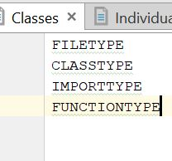
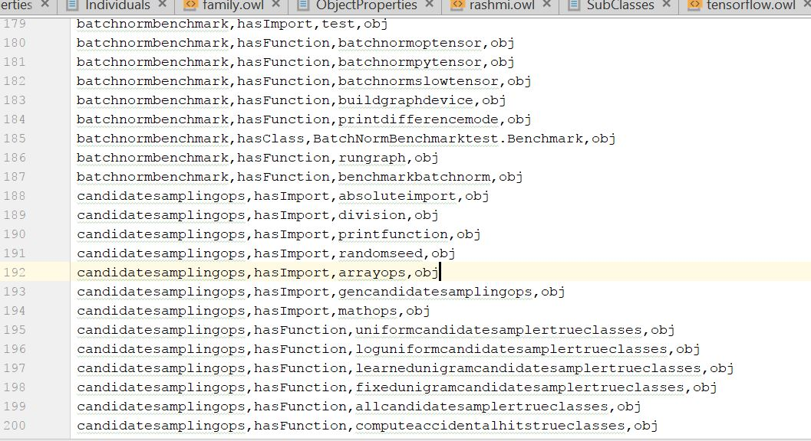
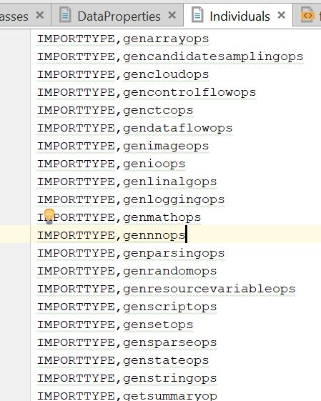
Dataset view

Slide 9
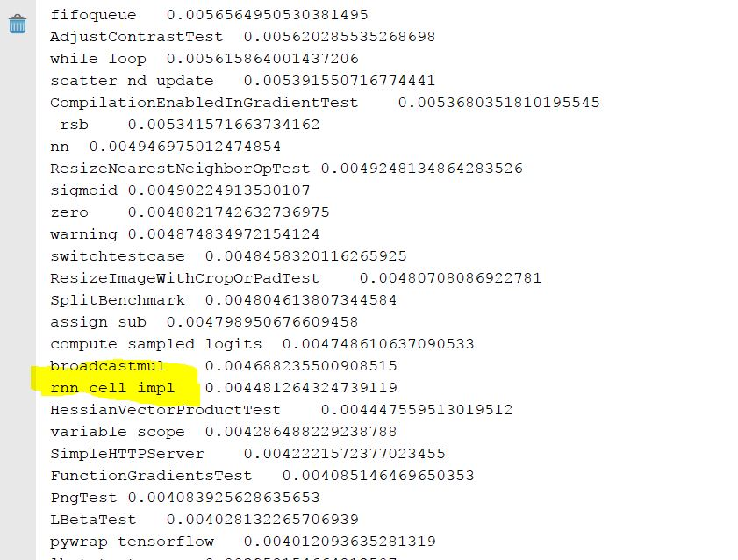
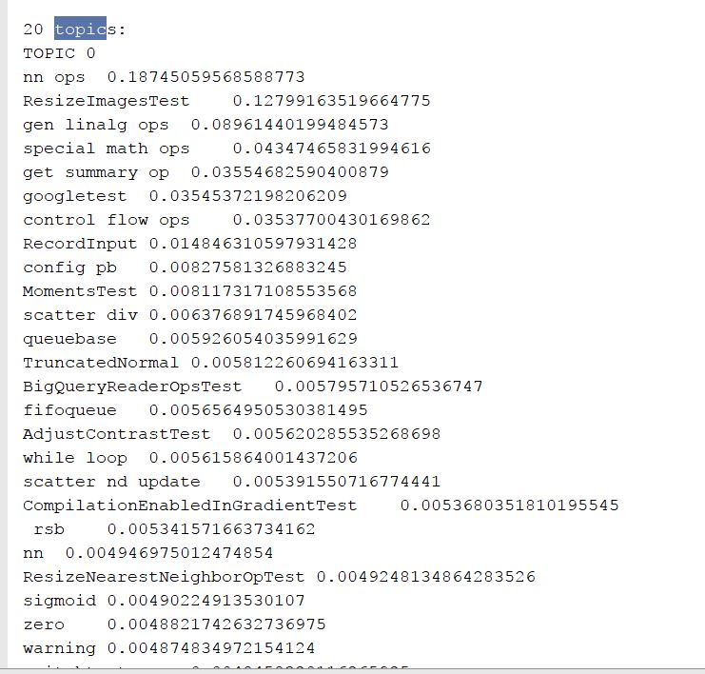
LDA : Top 20 topics

Slide 10
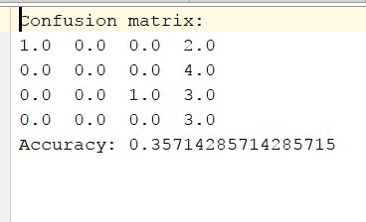
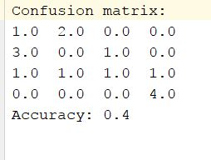
Classification using Random Forest and Naïve Bayes
Naïve Bayes
DT

Slide 11
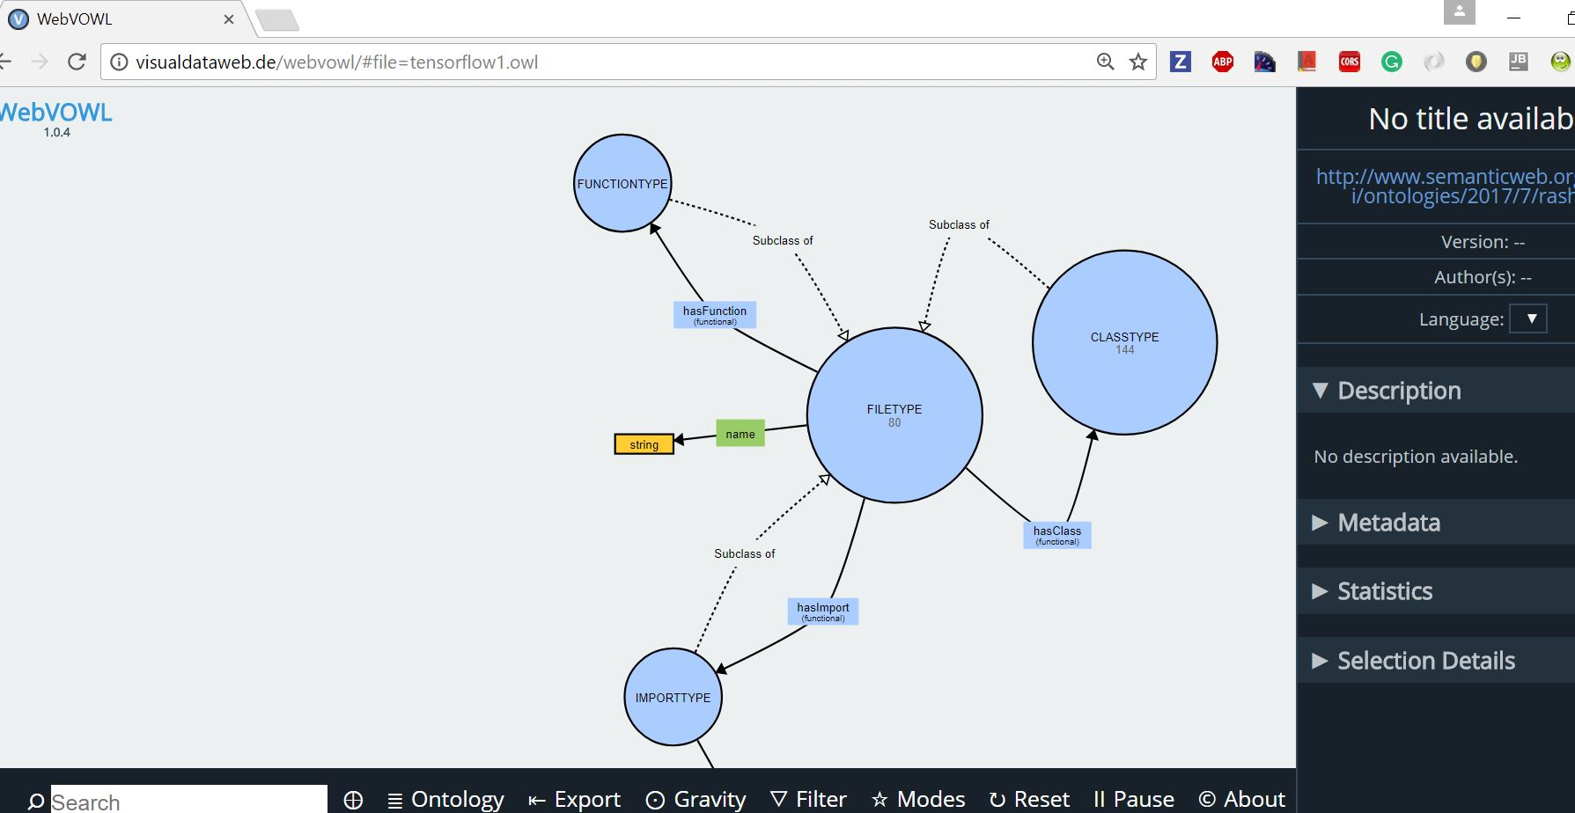
Output- Ontology

Slide 12
Triplets Generation- Manual one

Slide 13
Future Work
As variables are random in nature, need to figure out a way
How to treat where all classes of one package are treated
What about other members of python file ?How to extract information from them.

Slide 14


Slide 15


